Slide 1
Object Oriented Programming
Unit 2 Math Class

Slide 2
Outline
Static VS Instance Method
Math Class
Wrapper Class

Slide 3
Static VS (Non-static) Instance Method
Static method
Instance method
part of a class, rather than copied into each object
shared by all objects of that class.
called using the dot operator along with the class name
called directly if defined in the same enclosing class
part of an object, rather than shared by the class
called using the dot operator along with the object variable name.
usually implemented inside of an object class rather than the driver class.

Slide 4
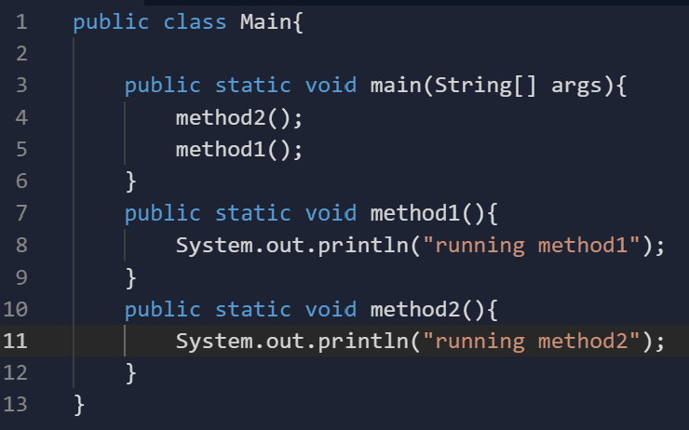
Static Method
Notes:
Homework 1: why is main method static?

Slide 5
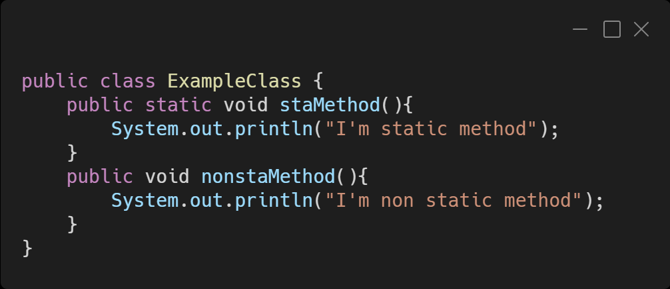
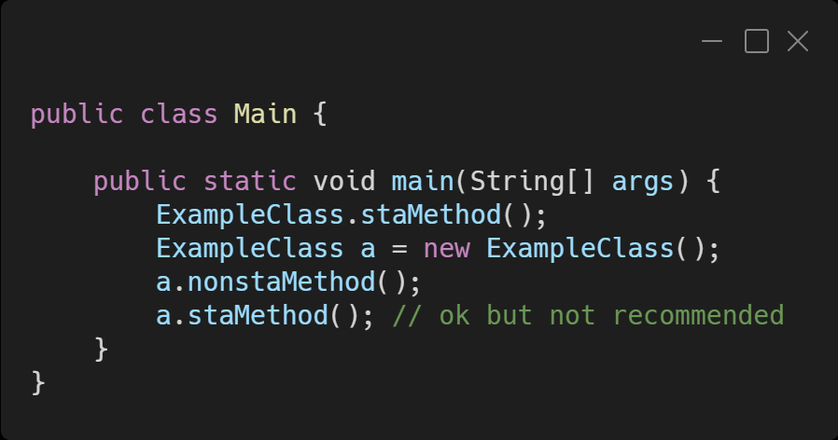
Calling Static Method

Slide 6
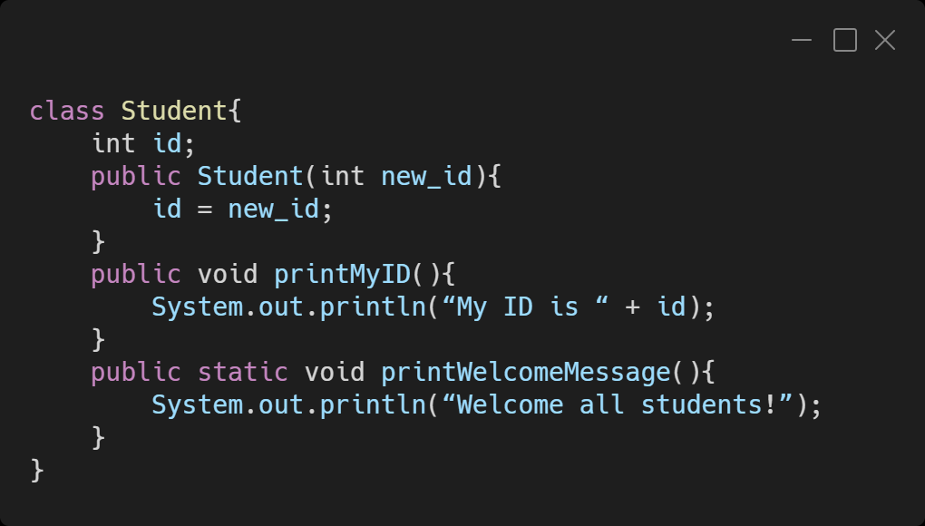
Example of using static method

Slide 7
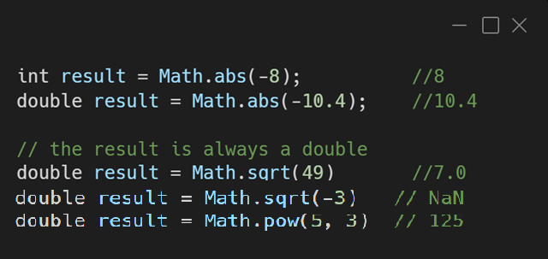
Math Class Methods
The Math methods do not print to the console, instead, each method produces ("returns") a numeric result.

Slide 8
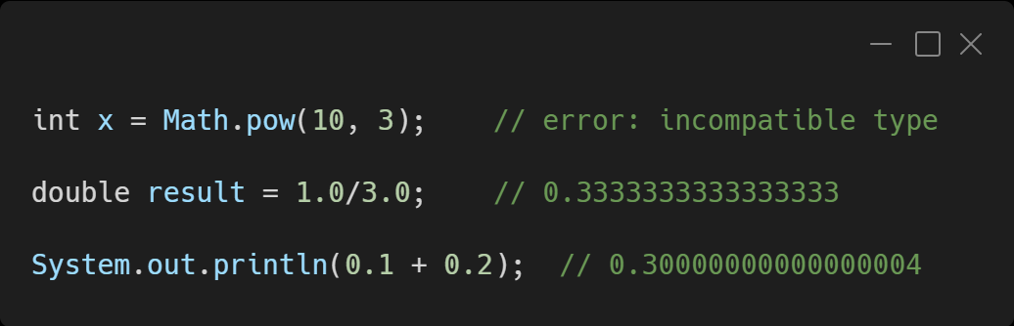
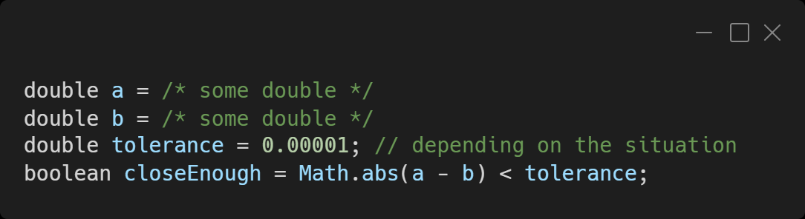
Quirks of numbers in Java
Best practice to compare if two doubles are equal:

Slide 9
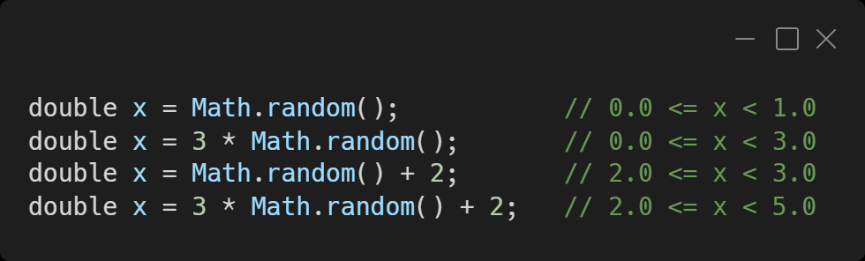
Math.random()
Math.random() method will return a double value in the interval of [0.0, 1.0)
To produce a random real number in the range [low,high):
double x = (high - low) * Math.random() + low; (exclusive)

Slide 10
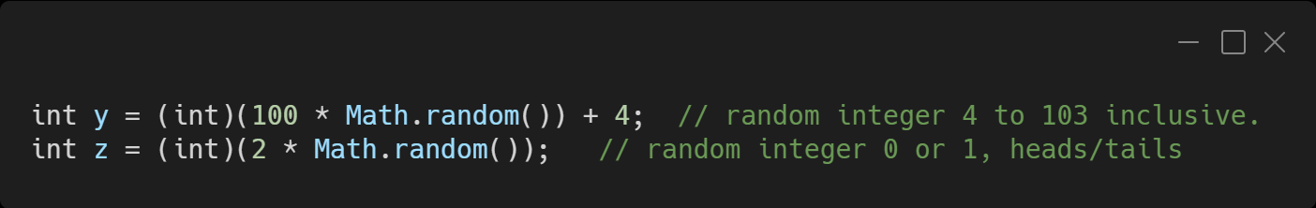
Math.random()
Use casting to generate random integers:
Generate a random integer between two positive number: by multiply Math.random() by total number of choice then casting
Int result = (int) (Math.random() * (high – low + 1)) + low; (inclusive)

Slide 11
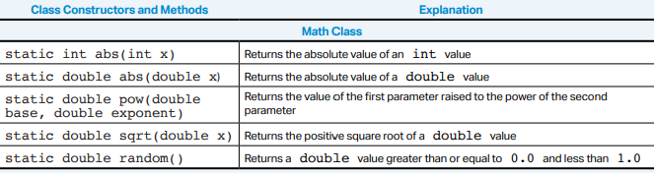
AP Java Quick Reference

Slide 12
Extra
Math.min()
Math.max()
Math.round()
Math.E
Math.PI
... ...

Slide 13
Wrapper Class
A wrapper class takes an existing value of primitive type and “wraps” or “boxes” it in an object, and provides a new set of methods for that type.
It can be used in Java container classes that requires the item to be objects. (Arraylist)

Slide 14
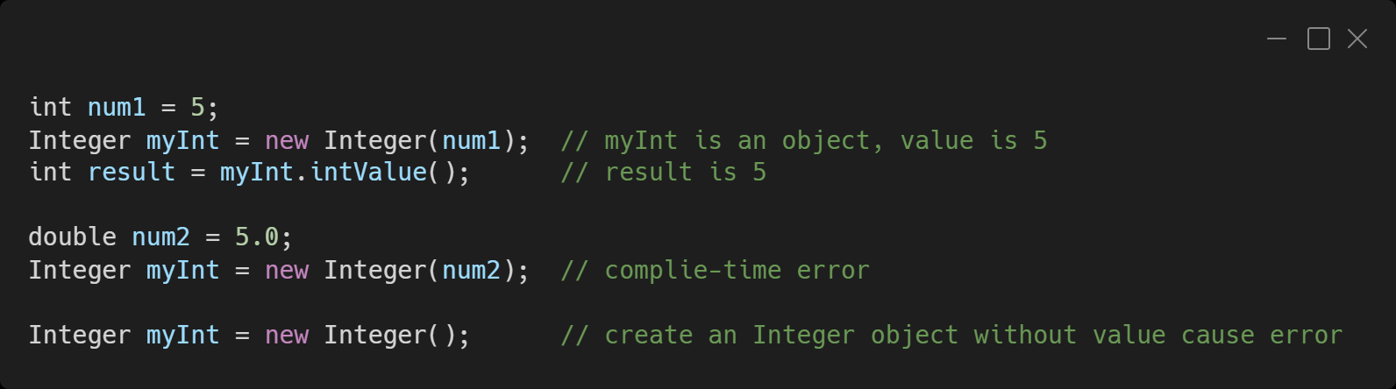
The Integer Class
Public field (constant) of the Integer Class:
Integer.MIN_VALUE
Integer.MAX_VALUE

Slide 15
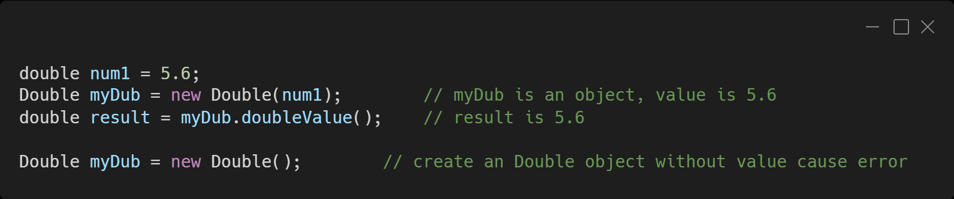
The Double Class

Slide 16
Exercises
Math.abs(), Math.random()

Slide 17
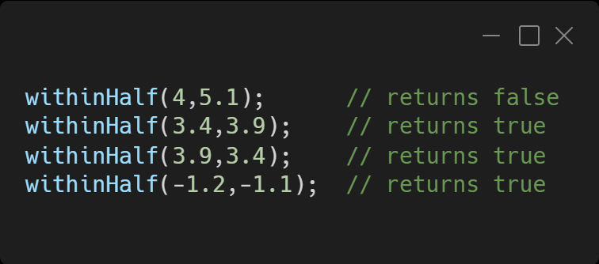
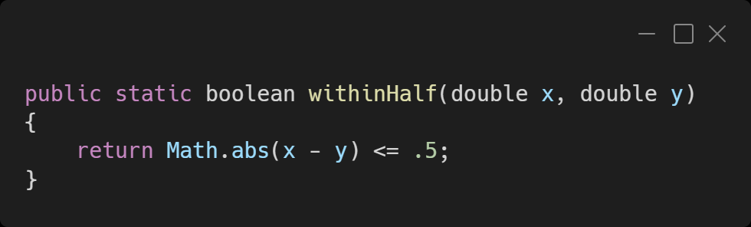
Exercise 1
Write a static method withinHalf which takes two double parameters and return true if they are within .5 of each other and false otherwise. Test your code against the following examples

Slide 18
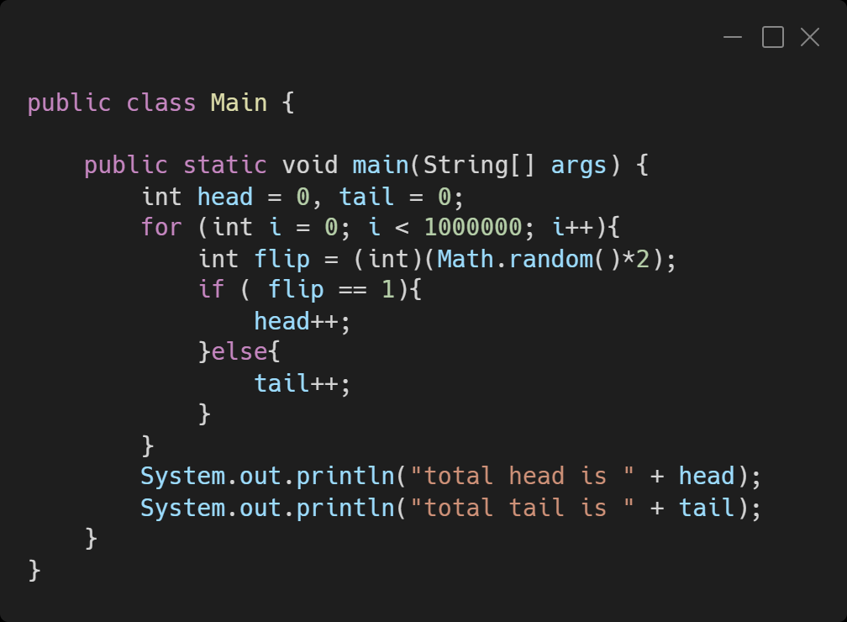
Exercise 2
Simulate flipping a coin a million times and calculate the total number of heads and tails respectively. Code in main().

